Slide 1

Tacos KFT.
Lajka Kristóf, Váradi Ádám és Enyedi Sándor Projektmunkája

Slide 2


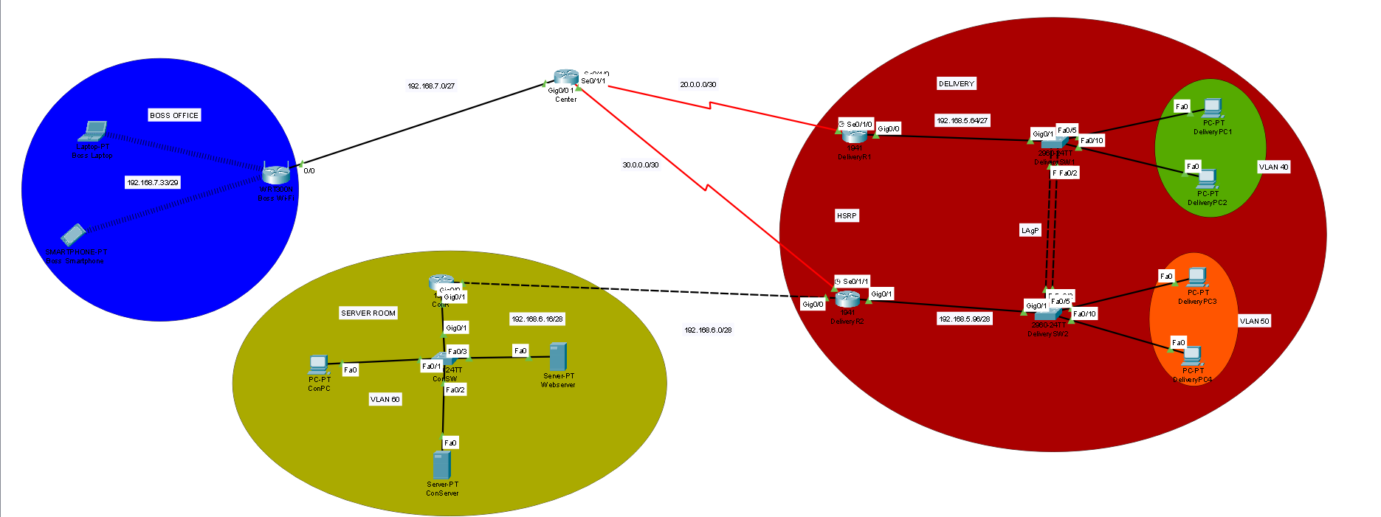



Topológia

Slide 3
IPv4/IPV6 tábla
Eszköz | Interface | IP | IPv6 | Subnet | Gateway
Center | Gig/0/0 Se0/1/0 Se0/1/1 | 192.168.7.1 20.0.0.1 30.0.0.1 | --------------------------------------------------------------------------------------------- | /27 /30 /30 | --------------------------------------------------------------------------------------------
Delivery R1 | Gig0/0.40 Se0/1/0 | 192.168.5.65 20.0.0.2 | 2001:ACAD:DB8:5::2/64 ------------------------------- | /27 /30 | ---------------------------------------------------------------------
Delivery R2 | Gig0/0.50 Se0/1/0 | 192.168.5.97 30.0.0.2 | 2001:ACAD:DB8:5::1/64 ------------------------------- | /28 /30 | ---------------------------------------------------------------------
ConR | Gig0/0 Gig0/1.60 | 192.168.6.2 192.168.6.17 | -------------------------------------------------------------- | /28 /28 | ---------------------------------------------------------------------
Boss Wi-Fi | Internet LAN | 192.168.7.2 192.168.7.33 | --------------------------------------------------------------------------------- | /29 /29 | 192.168.7.1
DeliverySW1 | VLAN 40 | ------------------------ | -------------- | --------- | ----------------------------------------------
DeliverySW2 | VLAN 50 | ------------------------ | -------------- | --------- | -----------------------
DeliveryPC1 | NIC | DHCP | SLAAC | /27 | 192.168.5.65
DeliveryPC2 | NIC | DHCP | SLAAC | /27 | 192.168.5.65
DeliveryPC3 | NIC | DCHP | SLAAC | /28 | 192.168.5.97
DeliveryPC4 | NIC | DHCP | SLAAC | /28 | 192.168.5.97
DeliveryServer | NIC | DHCP | SLAAC | /27 | 192.168.5.85
Laptop | Wireless | DHCP | -------------- | /29 | 192.168.7.1
Smartphone | Wireless | DHCP | -------------- | /29 | 192.168.7.1
ConPC | NIC | 192.168.6.20 | Stateful | /28 | 192.168.6.17
ConServer | NIC | 192.168.6.25 | 2001:ACAD:DB8:6::1/64 | /28 | 192.168.6.17

Slide 4
Vlan tábla
Eszköz neve | Azonosító | Név | Portok | Hálózat
DeliverySW1 | 40 99 | Delivery1 Trash | Fa0/5,Fa0/10,Fa0/3 Fa0/6-9,fa0/11-24,Gig0/2 | 192.168.5.64/27
DeliverySW2 | 50 99 | Delivery2 Trash | Fa0/5,Fa0/10 Fa0/3-4,Fa0/6-9,Fa0/11-24,Gig0/2 | 192.168.5.96/28
ConSW | 60 99 | ConVLAN Trash | Fa0/1, Fa0/2 Fa0/3-24,Gig0/2 | 192.168.6.16/28

Slide 5
Etherchannel
Protokoll | Port
LACP | Fa0/1, Fa0/2
LACP | Fa0/1, Fa0/2

Slide 6
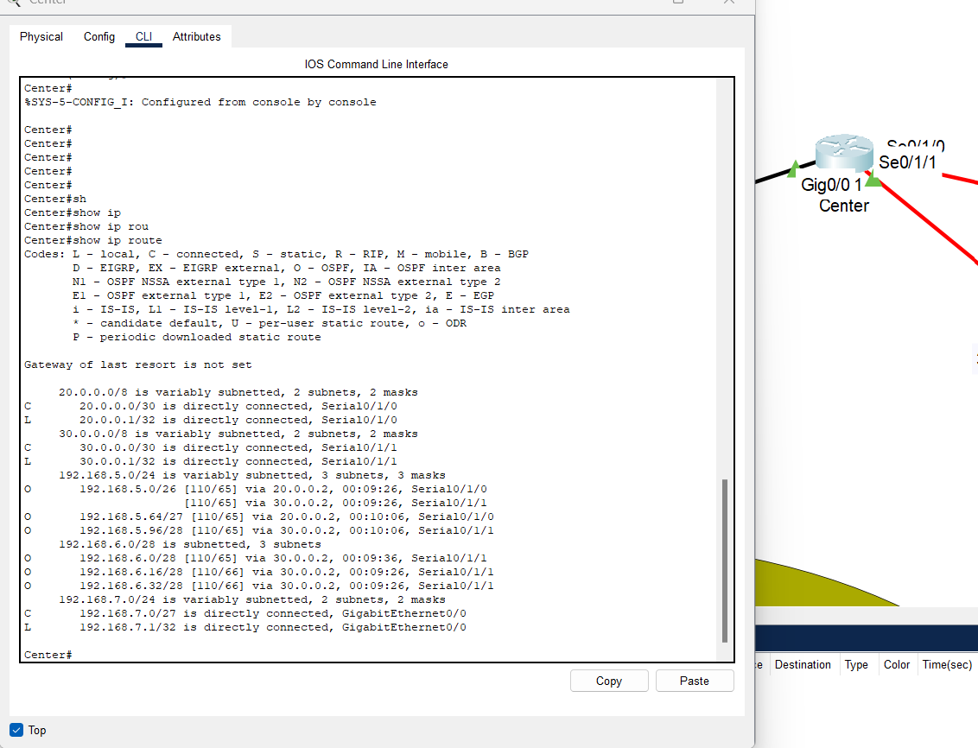
Route Table

Slide 7
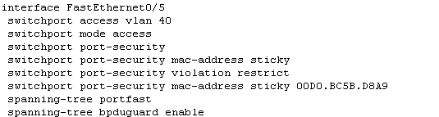
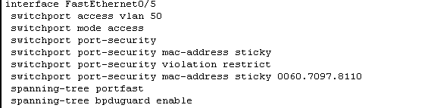
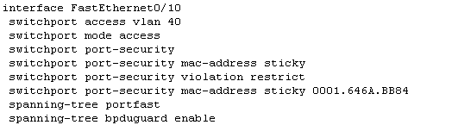
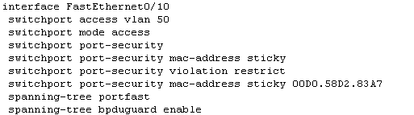
Port-Security,(BPDU Guard)
Delivery SW1
Delivery SW2

Slide 8
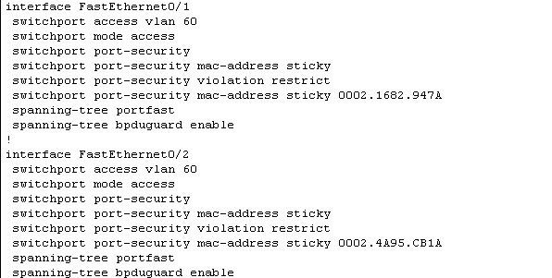
Port-Security,(BPDU Guard)

Slide 9
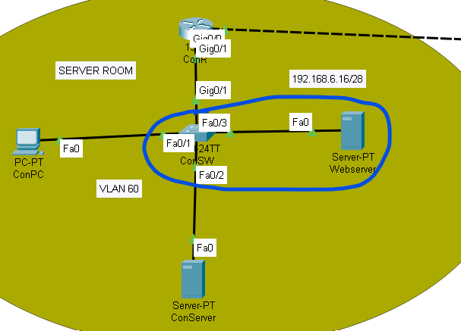
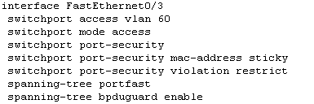
Port-security a Webszerver felé

Slide 10
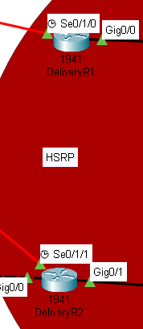
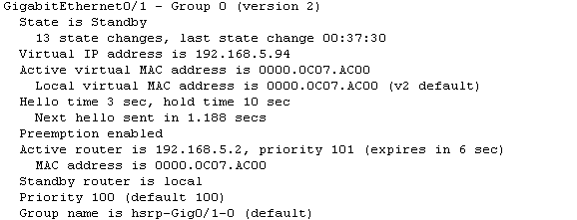
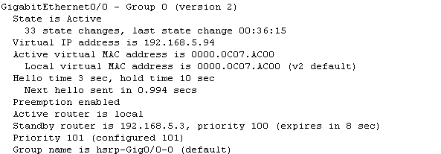
HSRP
DeliveryR1
DeliveryR2

Slide 11
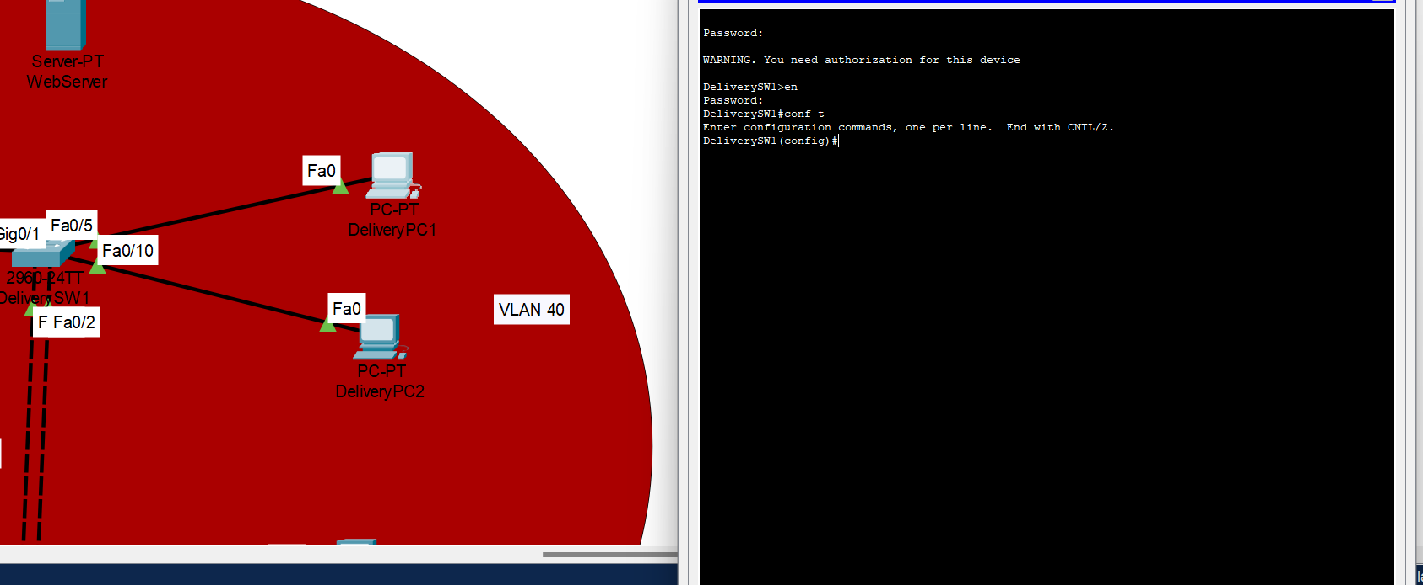
SSH

Slide 12
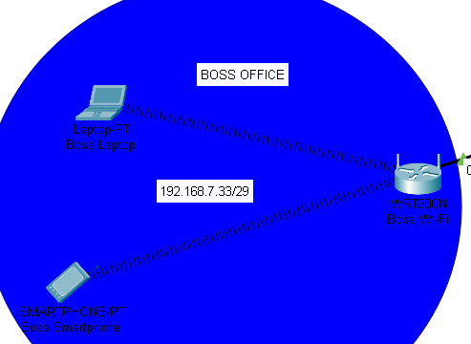
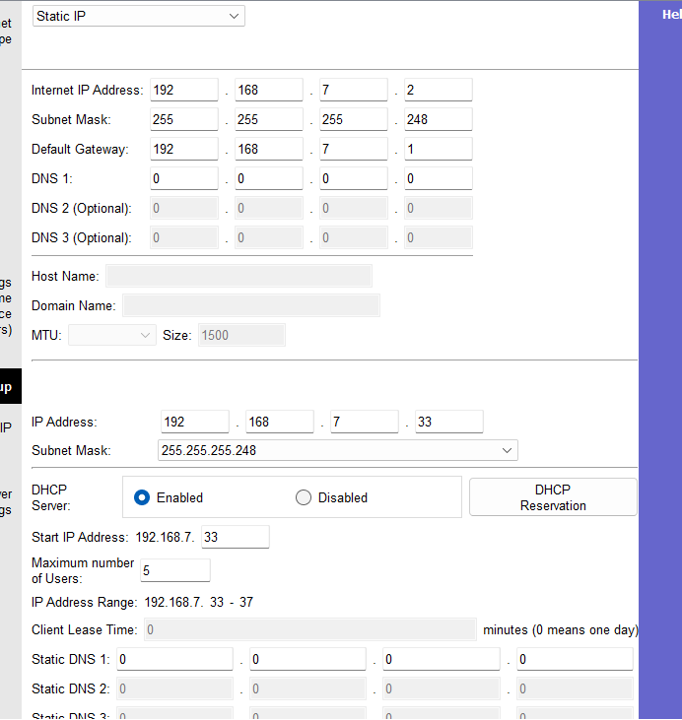
WIFI

Slide 13
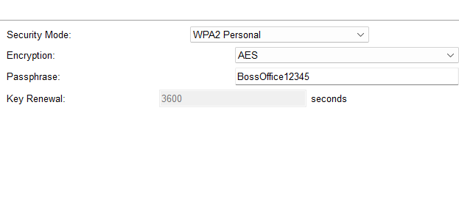
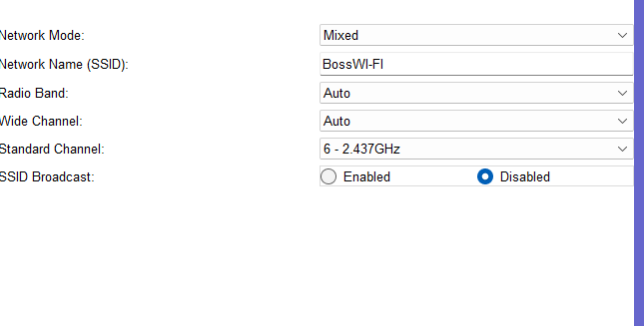
WIFI Security

Slide 14
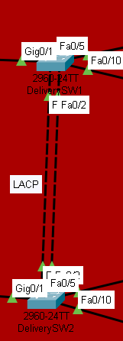
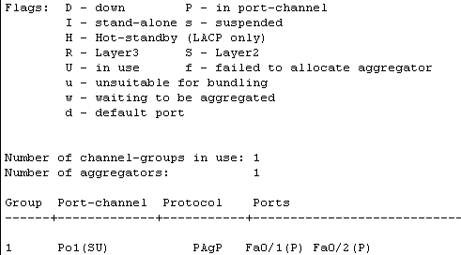
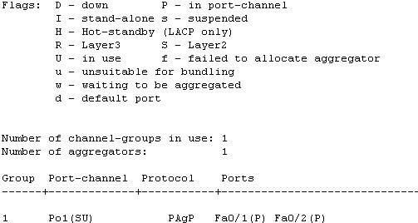
Etherchannel
Delivery SW1
DeliverySW2

Slide 15
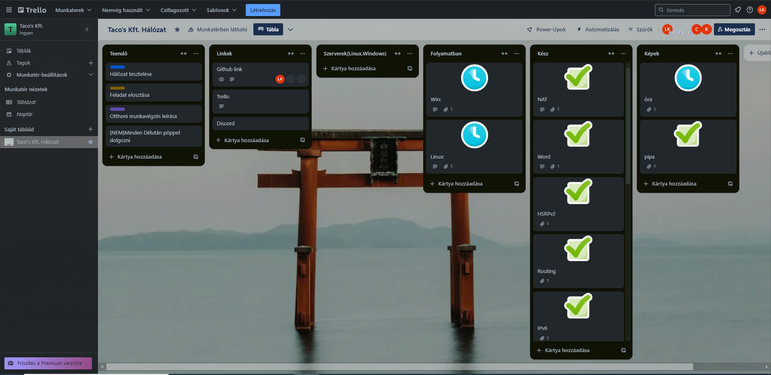
Trello használata

Slide 16
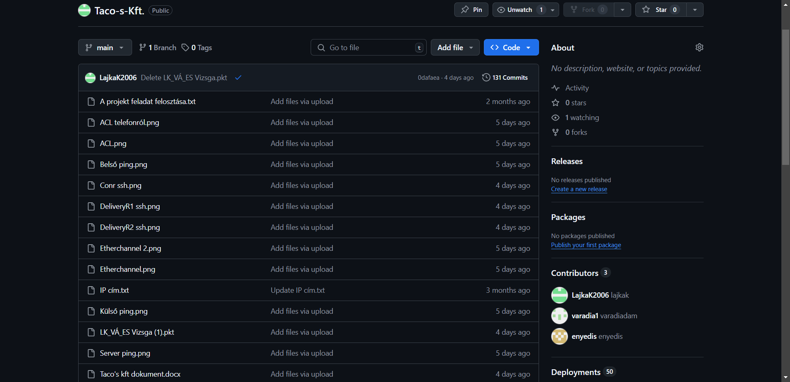
Github használata

Slide 17
Tesztelések

Slide 18




ACL
DeliveryR1
DeliveryR2
Center
ConR

Slide 19
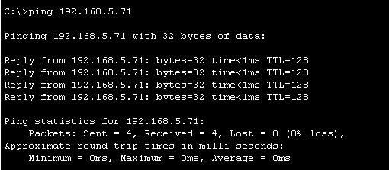
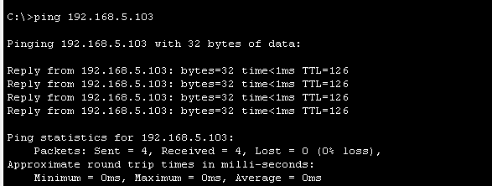
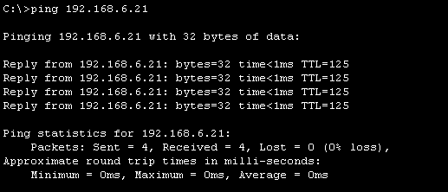
Pingelések
Beslő ping
Külső ping
Szerver ping

Slide 20
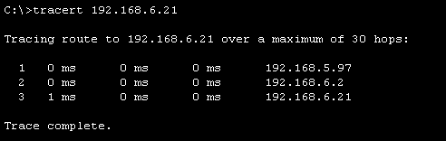
Trace route

Slide 21
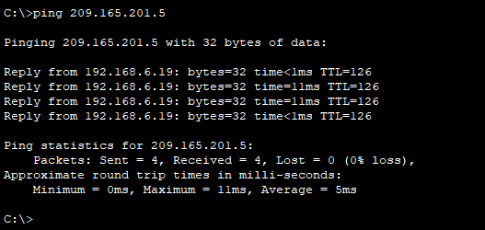
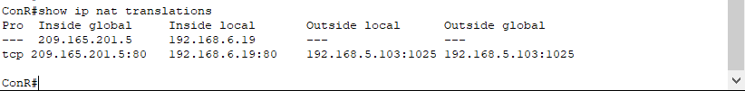
NAT

Slide 22
Köszönjük a figyelmet!

